Slide 1
Variable & Classes Java: Basics
Object Oriented Programming
Lecturer: GARRY SINGH
Manukau Institute of Technology

Slide 2
Introduction to Variables:
A variable is a name/label of a memory space that is used to store a value.
Example:
int i=10;
Developer will use the value 10 by name i in Java program
e.g. System.out.println(“The value is “+ i);
int
10
i

Slide 3
Variable
Each memory space in RAM also has real address(positive value) attached to it.
For example :
int i=10;
Data type specifies how much space is required to store an integer value
int
10
100
Real Memory Address
i
Value stored in Ram
Variable name

Slide 4
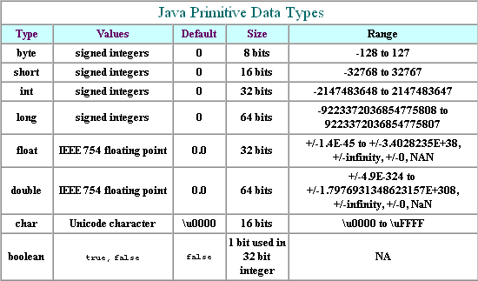
Data types in Java
All data items in a Java program have a data type
Data type describes the format and size of a piece of data
The following table shows the format and size information of number data types

Slide 5
Array Data Type
Sometimes storing just one value in memory at a time is not adequate
An array is a list of data items that all have the same type and same name
Example of array declaration:
double[] salesFigure;
Like objects, memory is not actually reserved until the new keyword is used
Example: salesFigure = new double[20];

Slide 6
Class- User defined data type
Sometimes we need a data type that is not provided by Java. In this situation, we can create our own data type using the class statement
Primary reason for class being a user defined data type is, since class is made up of combination of primitive data types(int,float,long..etc) specified by user. This combination could be different for different users hence type of data represented by the class is specific with user definition.

Slide 7
Class vs Object
Example: To store three values id, name and gender of a student, we can create following class.
class Student {
int id;
String name;
char gender;
}
Same as variable of Java inbuilt data type, we can declare variable of Student (user defined data type)
Student s;
At this stage operating system does not know how much space is required to store the student’s data.

Slide 8
Class vs Object
To allocate memory space to variable st of class Student , we need to write the following statement
Student st= new Student()
New is an operator that calculates how much memory is required for a class variable and requests operating system for calculated memory.
It is also called constructor of a class that stores default values for a class variable or an object. It is invoked after new operator finishes its job.

Slide 9
Example of a class and object
Class Student {
public int id;
public string name;
public char gender; }
public keyword is used to provide access to student values outside its own defined class.
Student st= new Student(); // create object of Stduent
st.id=10; st.name=“John”; st.gender=‘M’;
id
10
st
100
100
name
John
gender
M
Memory address
Actual memory address where student object values are stored

